Slide 1


Spoken Utterances Guiding Chef’s Assistant Robots SUGAR
Maria Di Maro, Antonio Origlia, Francesco Cutugno
Università degli Studi di Napoli ‘Federico II’

Slide 2
Outline to the task
SUGAR at Evalita 2018
Introduction to the task
Corpus Collection
Corpus Annotation
Participants
Evaluation
Metrics
Results
Conclusion

Slide 3
SUGAR at EVALITA 2018
Introduction to the task
Spoken Language Understanding:
Grammars (McGlashan et al., 1992)
Frame semantics (Wang, 2010)
Bag of words (Yao et al., 2013)
Semantic-syntactic trees (Miller et al., 1966)
Intent classification (Tur and Deng, 2011)

Slide 4
SUGAR at EVALITA 2018
Introduction to the task
Intent Classification-based task to train systems to understand spoken commands
Authentic spoken data collected in a simulated natural context
Manual Annotations for training purposes
Automatic extraction of semantic predicates to enable a (robotic) system to perform an action (cooking context)
Development of a suitable baseline

Slide 5
SUGAR at EVALITA 2018
Corpus Collection
3D virtual kitchen with Bastian “the interactive chef”
Silent video frames showing actions
Recording of user utterances in accomplishing recipes

Slide 6
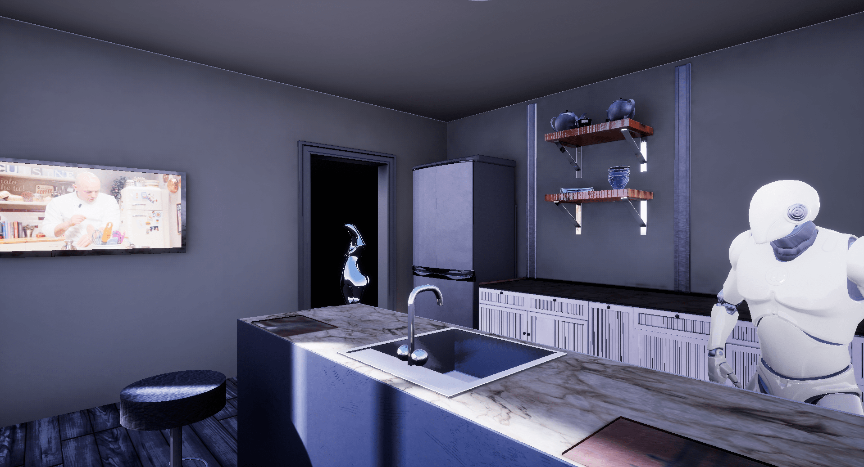
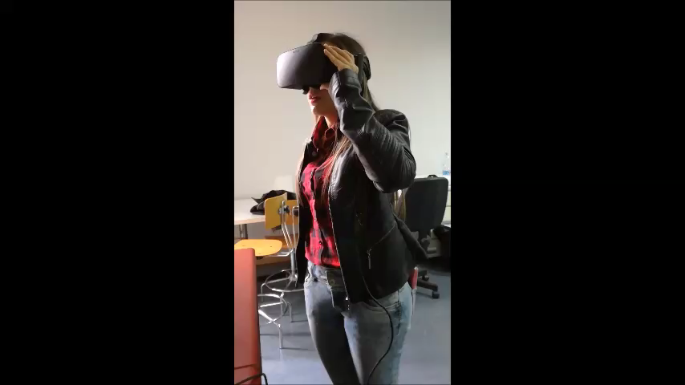
SUGAR at EVALITA 2018
Corpus Collection

Slide 7
SUGAR at EVALITA 2018
Corpus Annotation
Generic predicates + open domain-dependent set of parameters
put(pot, fire)
put(egg, bowl)
Training set: 1721 actions
Test set: 572 actions
Transcriptions were not provided
Data could be extended with external ontologies

Slide 8
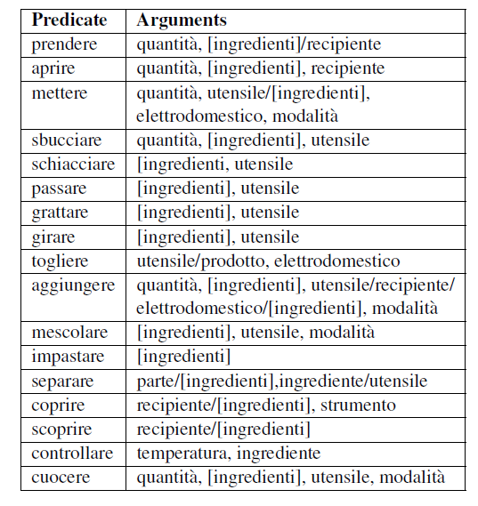
SUGAR at EVALITA 2018
Corpus Annotation: Action Templates

Slide 9

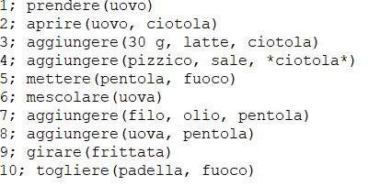
SUGAR at EVALITA 2018
Training set - Example

Slide 10
SUGAR at EVALITA 2018
Corpus Annotation
Challenging Scenarios:
Implicit arguments
Co-reference
Arguments expressed within the verb (i.e. instrumental verbs)
Generalization of actions (i.e. sciogliere(lievito, acqua) => mescolare([lievito, acqua]))

Slide 11
Participants
FBK-HLT-NLP | Anonymous System
System 1 Encoder-Decoder approach with memory of previous sentences System 2 Sequence to sequence modelling with synthetic data generation | Deep Neural Network System: Word embeddings lexicon trained on a corpus of recipes (4.5 million words) as features Two Bi-LSTM layers for the encoder (the first for the token sequences, the second to embed arguments in a vector) Two Bi-LSTM layers for the decoder (the first in charge of decoding the sequence of arguments and the second of decoding the sequence of tokens) Multi-task neural network to classify the actions, detect the implicitness and predict the arguments.

Slide 12
Evaluation
Metrics
The proposed system correctly detects the requested action and all its parameters
The proposed system asks for repetition
The proposed system correctly detects the requested action but it assigns wrong parameters
The proposed system misses the action

Slide 13
Evaluation
Metrics: Output
Action id (listing number of predicate + number of action)
Boolean Value indicating if the predicate has been recognized
Number of expected arguments
Distance between expected arguments and system outputted arguments (Levensthein distance)
Number of arguments for which the system asked for repetition
Reference File: prendere(500 g, panna) Output File: prendere(500 g, latte)
Evaluation Output: 1_1 (1, 2, 1, 0)

Slide 14
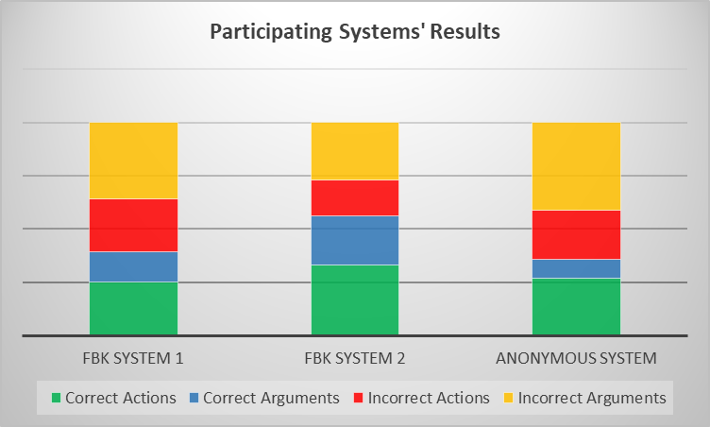
Evaluation
Results
 | Correct Actions | Correct Arguments | Incorrect Actions | Incorrect Arguments
FBK System 1 | 50,16 | 28,31 | 49,83 | 71.68
FBK System 2 | 66,36 | 46,22 | 33,64 | 53,78
Anonymous System | 55,89 | 17,46 | 46,11 | 82,54

Slide 15
Conclusion
Further analysis should be carried out to efficiently solve semantic recognition tasks
Errors analysis is needed
Enlargement of the corpus
Rule-based module?
Multilingualism and Multimodality

Slide 16
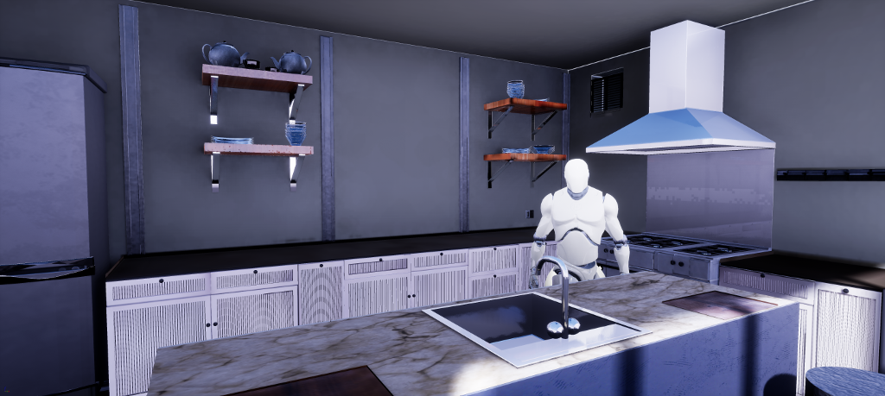
Thank you!

Slide 17
Spoken Utterances Guiding Chef’s Assistant Robots SUGAR
Maria Di Maro, Antonio Origlia, Francesco Cutugno
Università degli Studi di Napoli ‘Federico II’

